Slide 1


An Introduction to Machine Learning
Andrew Fryer

Slide 2
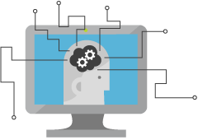
What is Machine Learning (ML)
Solve extremely hard problems
Extract more value from Big Data
Drive a shift in business analytics

Slide 3






Machine learning usage

Slide 4
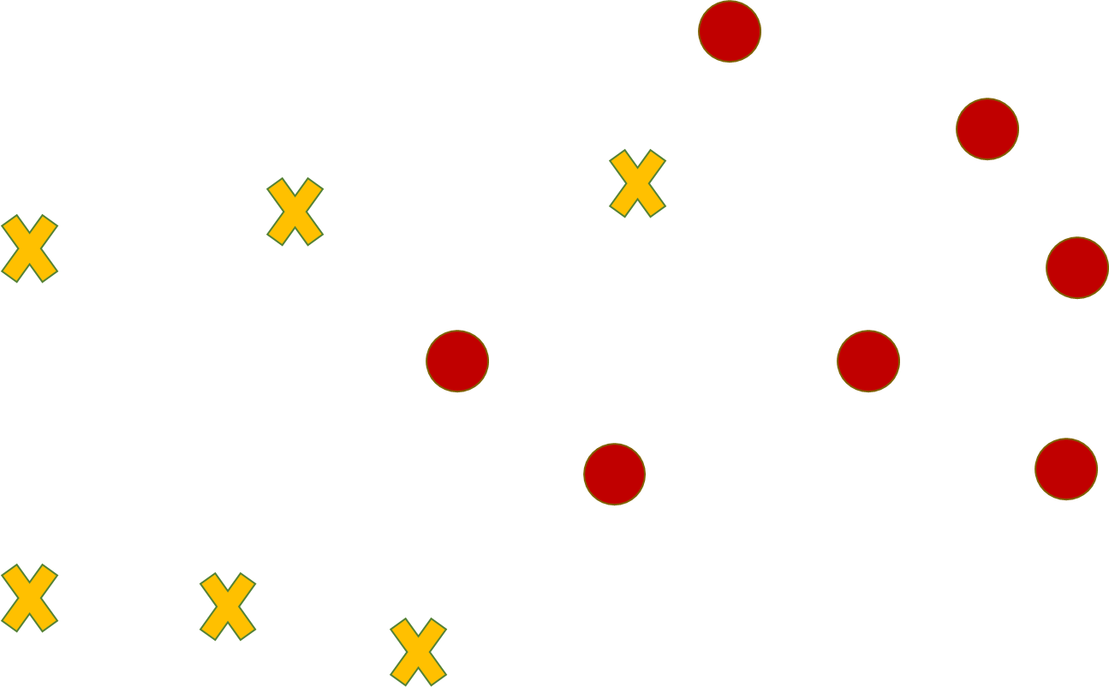
Classification in ML

Slide 5
Regression in ML

Slide 6
Clustering in ML

Slide 7
Text analytics in ML
“John enjoyed his vacation in the Dales. His personal favourite on the trip was Skipton Castle”
“John enjoyed his vacation in the Dales. His personal favourite on the trip was Skipton Castle.”
“<person>John</person> enjoyed his vacation in
<location>Dales</location>. His personal favourite on the trip was <location>Skipton Castle</location>.”

Slide 8
Machine learning pipeline
Idea
Business knowledge
Data Understanding
Data
Data preparation
Modelling
Evaluation
Publish

Slide 9



The future of machine learning
+
+
=

